Slide 1
Introduction to Computer Simulation of Physical Systems
(Lecture 9)
PHYS 3061

Slide 2
Modeling continuous systems
It is usually more difficult to simulate continuous systems than discrete ones,
  especially when the properties under study are governed by nonlinear equations.
The systems can be so complex
  that the length scale at the atomic level can be as important as the length scale at the macroscopic level.
The basic idea in dealing with complicated systems is similar to a divide-and-conquer concept,
  that is, dividing the systems with an understanding of the length scales involved and then solving the problem with an appropriate method at each length scale.

Slide 3
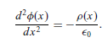
In order to show how a typical finite element method works for a specific problem,
  let us take the one-dimensional Poisson equation as an example.
Assume that the charge distribution is ρ(x) and the equation for the electrostatic potential is
In order to simplify our discussion here, let us assume that the boundary conditions given as φ(0) = φ(1) = 0.

Slide 4

we can always express the solution in terms of a complete set of orthogonal basis functions as
and u_{i} (0) = u_{i} (1) = 0.

Slide 5
We have assumed that u_{i} (x) is a real function and that the summation is over all the basis functions.
One of the choices for u_{i} (x) is to have u_{i} (x) = √2 sin iπx.
In order to obtain the actual value of φ(x), we need to solve all the coefficients a_{i} by applying the differential equation and the orthogonal condition
  This becomes quite a difficult task if the system has a higher dimensionality and an irregular boundary.

Slide 6
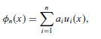
The finite element method is designed to find a good approximation of the solution for irregular boundary conditions or in situations of rapid change of the solution.
Typically, the approximation is still written as a series with a finite number of terms.
  Here u_{i}i (x) is a set of linearly independent local functions, each defined in a small region around a node x_{i}i .

Slide 7

If we use this approximation in the differential equation, we have a nonzero value:
which would be zero if φ_{n}(x) were the exact solution.
The goal now is to set up a scheme that would make r_{n} (x) small over the whole region during the process of determining all a_{i} .

Slide 8
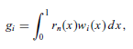
The selection of u_{i} (x) and the procedure for optimizing r_{n} (x) determine how accurate the solution is for a given n.
We can always improve the accuracy with a higher n.
One scheme for performing optimization is to introduce a weighted integral
which is then forced to be zero during the determination of a_{i} . Here w_{i} (x) is a
selected weight.

Slide 9
The procedure just described is the essence of the finite element method.
The region of interest is divided into many small pieces, usually of the same topology but not the same size, for example, different triangles for a two-dimensional domain.
Then a set of linearly independent local functions u_{i} (x) is selected, with each defined around a node and its neighborhood.
We then select the weight w_{i} (x),which is usually chosen as a local function as well.

Slide 10
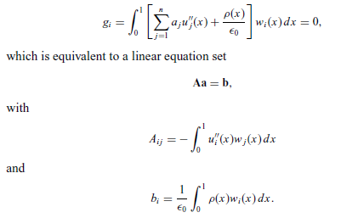
For the one-dimensional Poisson equation, the weighted integral becomes

Slide 11
The advantage of choosing u_{i} (x) and w_{i} (x) as local functions lies in the solution of the linear equation set.
Basically, we need to solve only a tridiagonal or a band matrix problem, which can be done quite quickly.
The idea is to make the problem computationally simple but numerically accurate.
That means the choice of the weight w_{i} (x) is rather an art.
A common choice is that w_{i} (x) = u_{i} (x), which is called the Galerkin method.

Slide 12
Simple classical and Monte Carlo methods
  including importance sampling
    illustrated in the context of the numerical evaluation of definite integrals.

Slide 13
Numerical and Monte Carlo
Methods

Slide 14
Numerical Integration Methods in One Dimension
We can use sequences of random numbers to estimate definite integrals,
  seemingly has nothing to do with randomness.
Several common classical methods
  for numerically evaluating definite integrals.
Any suggestions on how to do such integrations with classical methods or with randomness?

Slide 15
one-dimensional definite integral:
F =∫_{a}^{b} f(x) dx. (1)
For some f(x),
  the integration can be done analytically,
  Found in tables of integrals,
  or evaluated as a series.
  Or with the help of software like mathematica.

Slide 16
However, relatively few functions can be evaluated analytically
most functions must be integrated numerically.

Slide 17
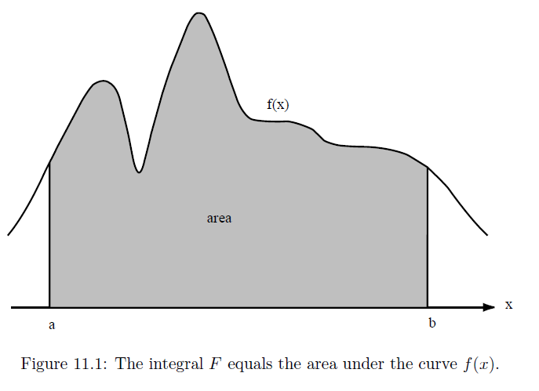
Most classical methods of numerical integration are based on the geometrical interpretation of the integral as the area under the curve of the function f(x) from x = a to x = b.

Slide 18
In these methods the x-axis is divided into n equal intervals of width Δx, where Δx is given by
Δx =(b − a)/n,
And x_{n} = x₀ + nΔx.
In the above, x₀ = a and x_{n} = b.

Slide 19
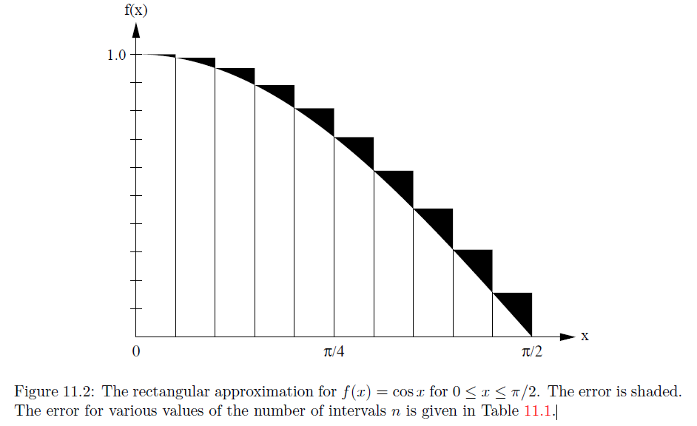

Slide 20
The simplest approximation of the area under the curve f(x): the sum of the area of the rectangles.
In the rectangular approximation, f(x) is evaluated at the beginning of the interval, and the approximate of the integral, F_{n}, is given by
F_{n} =Σf(xi)Δx. i = 0… n-1 (rectangular approximation.)

Slide 21
In the trapezoidal approximation the integral is approximated by a sum of trapezoids.
The area is computed by choosing one side equal to f(x) at the beginning of the interval and the other side equal to f(x) at the end of the interval.

Slide 22
This approximation is equivalent to replacing the function by a straight line connecting the values of f(x) at the beginning and the end of each interval.
Because the area of the trapezoid from xi to xi+1 is given by 1/2 [f(xi+1) + f(xi)]Δx,
The total area Fn of the trapezoids is given by
Fn =[1/2f(x0) +Σf(xi) +1/2f(xn)]Δx. i = 1 … n-1, (trapezoidal approximation)
Any further improvements of accuracies?

Slide 23
A generally more accurate method is to use a quadratic or parabolic interpolation procedure through adjacent triplets of points.
For example, the equation of the second-order polynomial that passes through the points (x0, y0), (x1, y1), and (x2, y2) can be written as
y(x) =(x − x1)(x − x2) y0 /[(x0 − x1)(x0 − x2)] +(x − x0)(x − x2)y1/[(x1 − x0)(x1 − x2)]+(x − x0)(x − x1)y2/[(x2 − x0)(x2 − x1)].

Slide 24
The area under the parabola y(x) between x0 and x2 can be found by integration and is given by
F₀ =1/3 (y0 + 4y1 + y2)Δx,
where Δx = x1−x0 = x2−x1.
The total area under all the parabolic segments yields the parabolic approximation for the total area:
Fn =1/3 [f(x0) + 4f(x1) + 2f(x2) + 4f(x3) + . . .+ 2f(xn−2) + 4f(xn−1) + f(xn)] Δx. (Simpson’s rule)

Slide 25
This approximation is known as Simpson’s rule,
  although a more descriptive name would be the parabolic approximation.
  Note that Simpson’s rule requires that n be even.
  Why?

Slide 26
To write a program of the rectangular approximation=>
  we must define the function we wish to integrate.
Although we could define a new integration class for each function
or change the function in the class and recompile each time,
Convenient to input the name of the function as a string
then parse the string so that the function can be evaluated.

Slide 27
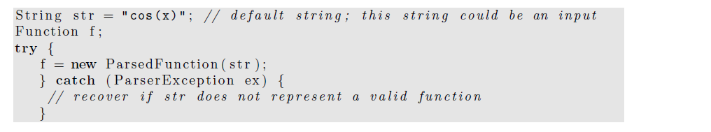
Because the Parsed Function often is used with keyboard input and it is common for users to mistype the name of a function,
the ParsedFunction constructor throws an exception that must be caught.

Slide 28
One way to display a function in a drawing panel:
to evaluate the function f(x) at various x values
and plot the (x, f(x)) data points.
Although we could do so using a loop
  to add a predetermined number of points to a data set,
a better way is to use the FunctionDrawer class in the display package.

Slide 29
The FunctionDrawer evaluates a given function at every pixel location within a drawing panel
thereby producing a plot with optimum resolution.
// drawingPanel c r e a t e d p r e v i o u s l y
drawingPanel . addDrawable (new FunctionDrawer ( f ) ) ;

Slide 30
We next define the class RectangularApproximation
  which computes the area under the curve using the rectangular approximation.
  This class also displays the rectangles used to compute the area.
Note how we have extended the Dataset class to produce the visualization.

Slide 31
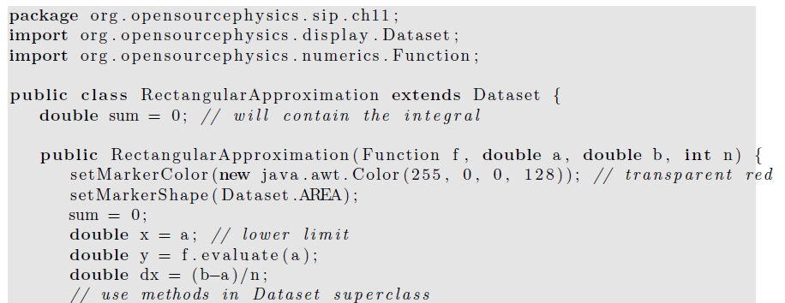

Slide 32
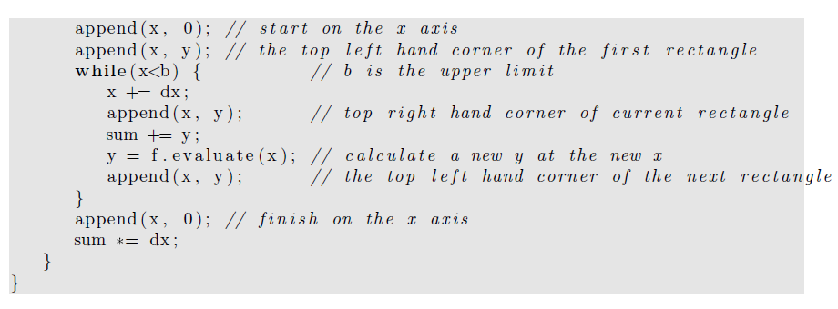

Slide 33
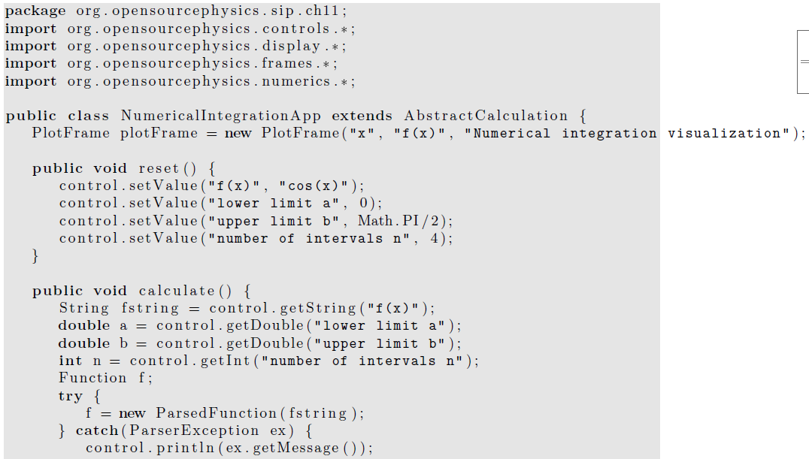
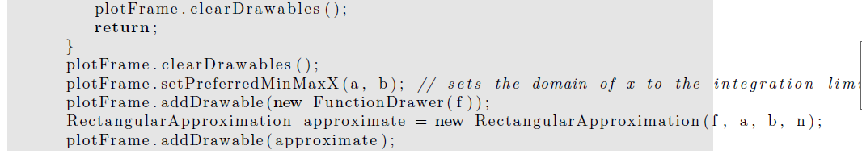

Slide 34
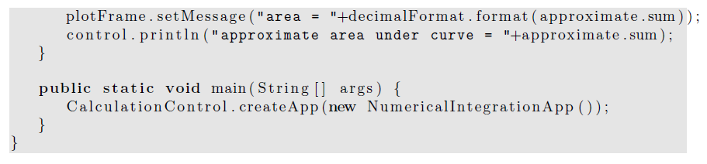

Slide 35
We consider the accuracy of the rectangular approximation for the integral of f(x) = cos x from x = 0 to x = π/2 by comparing the numerical results shown in Table 11.1
with the exact answer of unity.
Note that the error decreases as n⁻¹.
This observed n⁻¹ dependence of the error is consistent with the analytical derivation of the n dependence of the error.

Slide 36
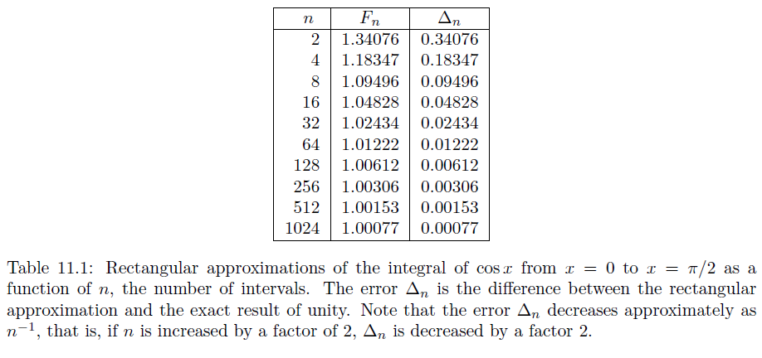

Slide 37
The rectangular and trapezoidal algorithms converge relatively slowly
and are therefore not recommended in general.
In practice, Simpson’s rule is adequate for functions that are reasonably well behaved,
  that is, functions that can be adequately represented by a polynomial.
How do we decide whether the our choices of n is large enough to provide accurate results?

Slide 38
If f(x) is such a function,
we can adopt the strategy of evaluating the area for a given number of intervals n and
then doubling the number of intervals and evaluating the area again.
If the two evaluations are sufficiently close to one another, we stop.
Otherwise, we again double n until we achieve the desired accuracy.

Slide 39
this strategy will fail if f(x) is not well behaved.
An example of a poorly behaved function is f(x) = x^{−1/3} at x = 0,
where f(x) diverges.
Another example where this strategy might fail is when a limit of integration is equal to ±∞.
How do we handle this type of problems?

Slide 40
In many cases we can eliminate the problem by a change of variables.

Slide 41
Because integration is usually a routine task,
the integration methods discussed in this section are implemented in the Integral class in the numerical package.
Method Integral.ode computes the integrals using an ODE solver
  as discussed in the following.
The solver uses an adaptive step size to achieve the desired tolerance.

Slide 42
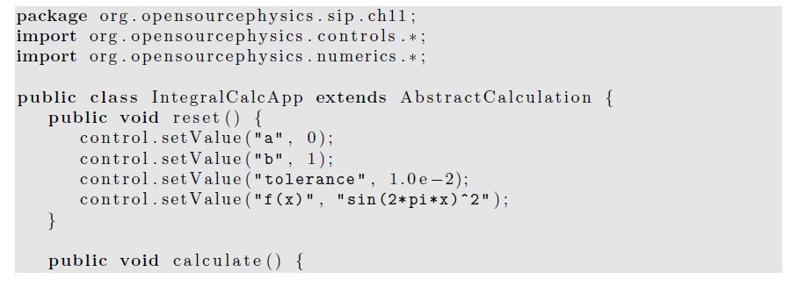

Slide 43
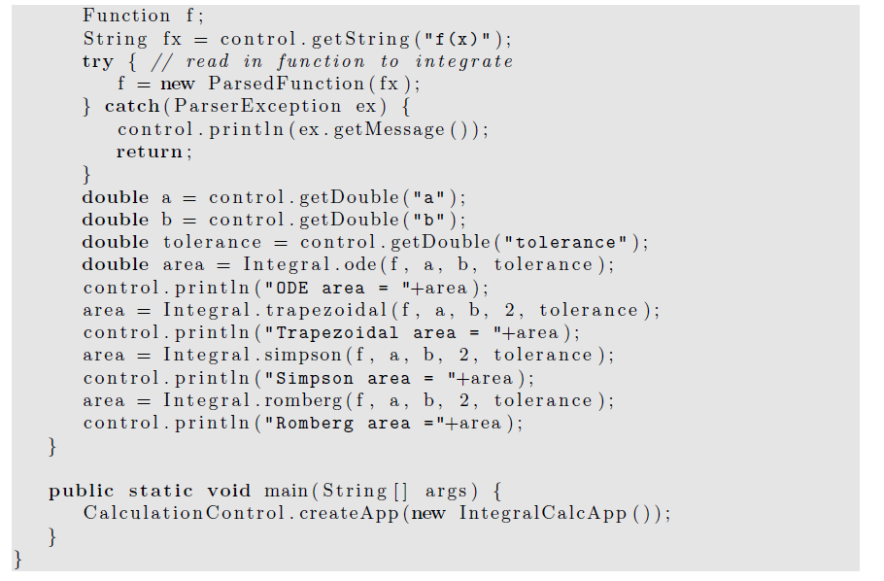

Slide 44
The algorithms in the Integral class are implemented using static methods
so that they are easy to invoke.
These methods accept a tolerance parameter that allows the user to specify the acceptable relative precision.
Because computers store floating point numbers using a fixed number of decimal places,
we use relative precision to determine the accuracy of the integration method.

Slide 45
However, relative precision is meaningful
  only if the result is different from zero.
If the result is zero, the only possible check is for absolute precision.

Slide 46
Another way of evaluating one-dimensional integrals is to recast them as differential equations.
Consider an indefinite integral of the form
F(x) =∫^{x}_{a}f(t) dt, (a)
where F(a) = 0.
If we differentiate F(x) with respect to x, we obtain the first-order differential equation:
dF(x)/dx= f(x). (b) with the boundary condition F(a) = 0.

Slide 47
Because the function f(x) is known, equation (b) can be solved for F(x) using the numerical algorithms
  that we introduced earlier
  for obtaining the numerical solutions of first-order differential equations.

Slide 48
In general, the methods for solving ordinary differential equations and evaluating numerical integrals are not equivalent.
For example, we cannot use Simpson’s rule to obtain the numerical solution of an differential equation of the form dy/dx = f(x, y).

Slide 49
Simpson’s rule fails (or is slowly convergent)
  if the function has regions of rapid change.
In this case, an adaptive step-size ODE algorithm is usually effective.
The RK45MultiStep solver adapts the integration step to the behavior of the integrand and allows the user to set the tolerance.

Slide 50
As computers become more powerful
and software to perform mathematical operations and numerical analysis becomes more prevalent,
there is a strong temptation to use libraries by others.
This use is appropriate because usually these libraries are well written,

Slide 51
and there is no reason why a user should re-invent them.
However, the downside is that users do not always know or care what the libraries are doing and sometimes can obtain puzzling or even incorrect results.

Slide 52
Simple Monte Carlo Evaluation of Integrals
We now explore a much different method of estimating integrals.
Consider the following example.
Suppose an irregularly shaped pond is in a field of known area A.
The area of the pond can be estimated by throwing stones so that they land at random within the boundary of the field
And counting the number of splashes
  that occur when a stone lands in a pond.

Slide 53
The area of the pond is approximately the area of the field times the fraction of stones that make a splash.
This simple procedure is an example of a Monte Carlo method.

Slide 54
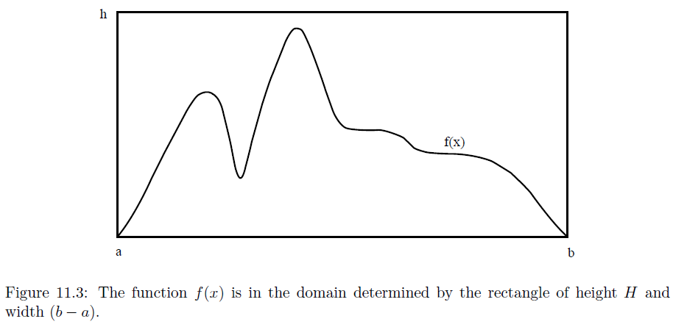
To be more specific, imagine a rectangle of height h, width b − a, and area A = h(b − a)
Such that the function f(x) is within the boundaries of the rectangle .
Compute n pairs of random numbers xi and yi with a ≤ xi ≤ b and 0 ≤ yi ≤ h.

Slide 55
The fraction of points xi, yi that satisfy the condition yi ≤ f(xi) is an estimate of the ratio of the integral of f(x) to the area of the rectangle.
Hence, the estimate F_{n} in the hit or miss method is given by F_{n} = An_{s}/n, (hit or miss method) (c)
where ns is the number of points below the curve or “splashes,”
and n is the total number of points.
Any other methods to apply random processes to compute integrations?

Slide 56
The number of points chosen at random in equation (c) should not be confused with the number of intervals used in the numerical methods discussed in Section 1.
Another Monte Carlo integration method is based on a mean-value theorem of integral calculus,
  which states that the definite integral (11.1) is determined by the average value of the integrand
f(x) in the range a ≤ x ≤ b: F =∫_{a}^{b} f(x)dx = (b − a)⟨f⟩.

Slide 57
To determine ⟨f⟩, we choose the x_{i} at random instead of at regular intervals and sample the values of f(x).
For the one-dimensional integral,
the estimate Fn of the integral in the sample mean method is given by Fn = (b − a) 1/n Σf(xi) ≈ (b − a)⟨f⟩. i=1…n, (sample mean method)

Slide 58
The xi are random numbers distributed uniformly in the interval a ≤ xi ≤ b, and n is the number of samples.
Note that the forms of rectangular method and random sampling are formally identical except that the n points are chosen with equal spacing in former one and with random spacing in the latter one.
We will find that for low dimensional integrals, rectangular is more accurate, but for higher dimensional integrals, random samplingdoes better.

Slide 59
A simple program that implements the hit or miss method is given in Listing 4.
Note the use of the Random class and the methods setSeed and nextDouble().
The primary reason that it is desirable to specify the seed
  rather than to choose it more or less at random from the time (as is done by Math.random())
  is that it is convenient to use the same random number sequence when testing a Monte Carlo program.

Slide 60
Suppose that your program gives a strange result for a particular run.
If we find an error in the program, we can use the same random number sequence
  to test whether our program changes make any difference.
Another reason for specifying the seed is
  so that other users can reproduce your results.

Slide 61
Listing 11.4: MonteCarloEstimatorApp displays the estimate of the integral for the number of samples equal to 2p.
package org.opensourcephysics.sip.ch11;

Slide 62
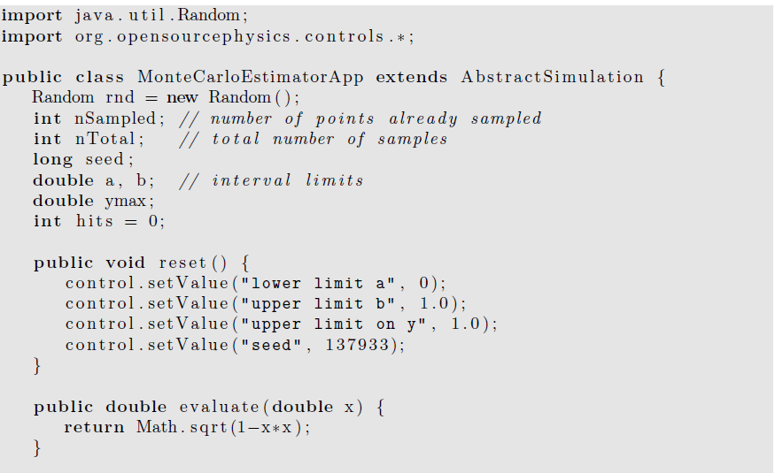

Slide 63
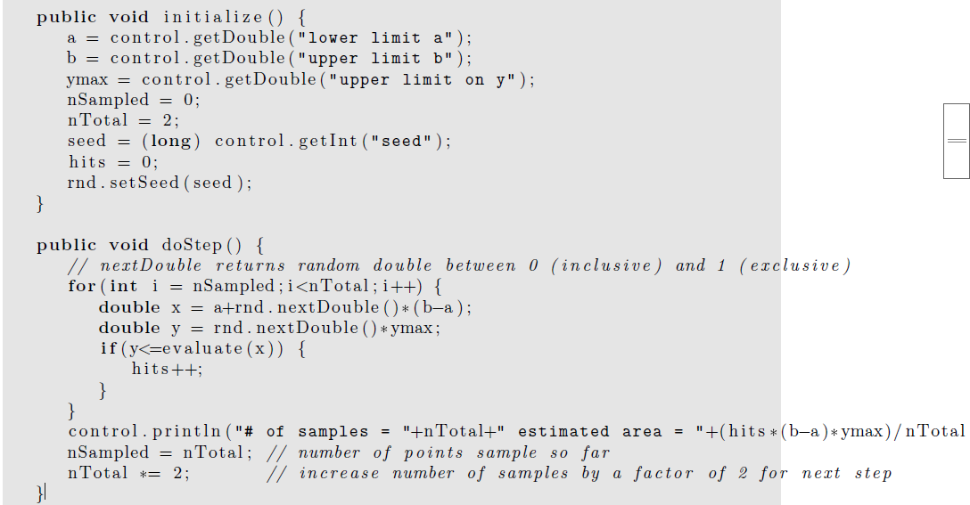

Slide 64
public static void main ( String [ ] args ) {
SimulationControl.createApp (new MonteCarloEstimatorApp ( ) ) ;
}
}

Slide 65
Multidimensional Integrals
Many problems in physics involve averaging over many variables.
For example, suppose we know the position and velocity dependence of the total energy of ten interacting particles.
In three dimensions,
  each particle has three velocity components
  and three position components.

Slide 66
Hence the total energy is a function of 60 variables,
and a calculation of the average energy per particle involves computing a d = 60 dimensional integral.
More accurately, the total energy is a function of 60 − 6 = 54 variables
  if we use center of mass and relative coordinates.

Slide 67
If we divide each coordinate into p intervals, there would be p⁶⁰ points to sum.
Clearly, standard numerical methods such as Simpson’s rule would be impractical for this example.

Slide 68
A discussion of the n dependence of the error associated with the standard numerical methods for d-dimensional integrals is given in Appendix 11A. (We’ll cover it in the next lecture.)
We show that if the error decreases as n^{−a} for d = 1,
then the error decreases as n^{−a/d} in d dimensions.
In contrast, we find that the error for all Monte Carlo integration methods decreases as n^{−1/2} independently of the dimension of the integral.

Slide 69
Because the computational time is roughly proportional to n in both the classical and Monte Carlo methods,
we conclude that for low dimensions, the classical numerical methods
  such as Simpson’s rule are preferable to Monte Carlo methods
unless the domain of integration is very complicated.
However, Monte Carlo methods are essential for higher dimensional integrals.

Slide 70
To illustrate the evaluation of multidimensional integrals, we consider the two-dimensional
Integral F = ∫_{R}f(x, y) dxdy
where R denotes the region of integration.

Slide 71
The extension to higher dimensions is straightforward,
  but tedious.
A simple illustration:
Form a rectangle that encloses the region R,
and divide this rectangle into squares of length h.
Assume that the rectangle runs from xa to xb in the x direction and from ya to yb in the y direction.

Slide 72
The total number of squares is n_{x}n_{y}, where n_{x} = (x_{b} − x_{a})/h and n_{y} = (y_{b} − y_{a})/h.
If we use the midpoint approximation, the integral F is estimated by
F ≈ΣΣ f(x_{i}, y_{j})H(x_{i}, y_{j}) h², i = 1… nx, j= 1… ny.
where x_{i} = x_{a} + (i − 1/2 )h,
y_{j} = y_{a} + (j − 1/2 )h, and the (Heaviside) function H(x, y) = 1 if (x, y) is in R and equals 0 otherwise.

Slide 73
A simple Monte Carlo method for evaluating a two-dimensional integral uses the same rectangular region,
but the n points (xi, yi) are chosen at random within the rectangle.
The estimate for the integral is then
Fn =A/nΣ f(xi, yi)H(xi, yi), i = 1 … n (d)
where A is the area of the rectangle.

Slide 74
Note that if f(x, y) = 1 everywhere, then Fn is equivalent to the hit or miss method of calculating the area of the region R.
In general, equation (d) represents the area of the region R multiplied by the average value of f(x, y) in R.

